Slide 1
Knowledge Distillation
Ansh Prakash

Slide 2
Overview
Knowledge distillation
Distillation Loss
Architecture
Dataset
Experiments
Conclusion

Slide 3
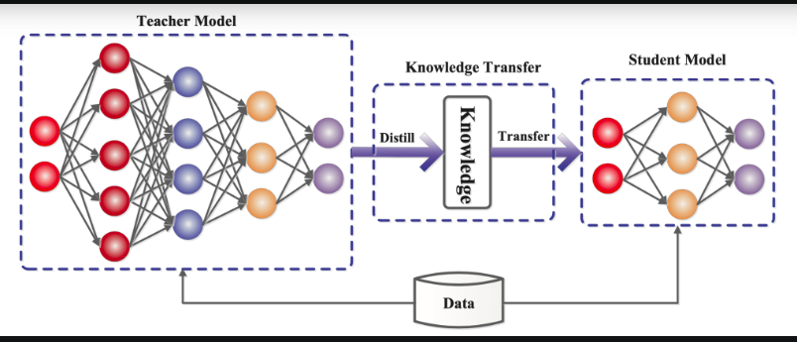
Source: https://neptune.ai/blog/knowledge-distillation

Slide 4
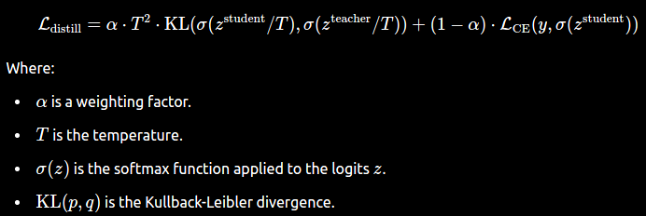
Distillation Loss

Slide 5
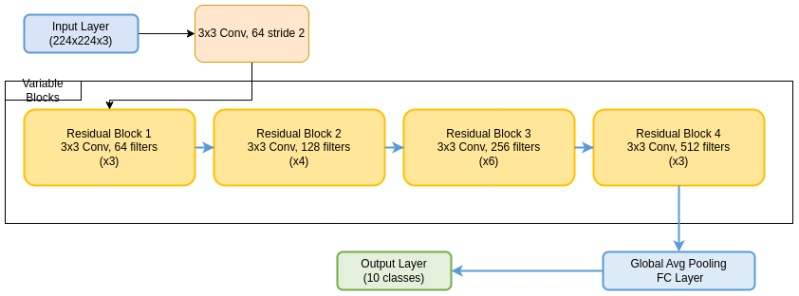
Architecture: ResNet Variants

Slide 6
ResNet Variants
Teacher: ResNet-10
Students:
ResNet-3
ResNet-4
ResNet-5
ResNet-6

Slide 7
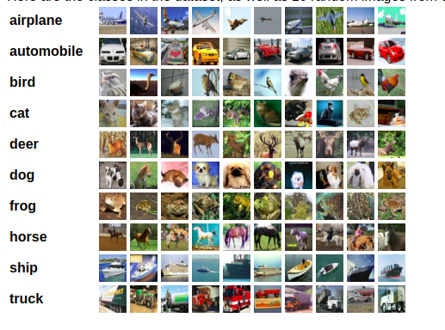
Dataset : CIFAR10

Slide 8
Dataset split
Generated the validation set from a random split to training set
20% used as Validation set and rest 80% for training
Test set is separately available

Slide 9
Baseline vs KD Results
Models | Baseline test accuracy % | KD test accuracy %
Renet-10[Teacher] | 90 | -
Resnet-3 | 64 | 67(+3)
Resnet-4 | 70 | 76(+6)
Resnet-5 | 82 | 84(+2)
Resnet-6 | 87 | 87(+0)

Slide 10
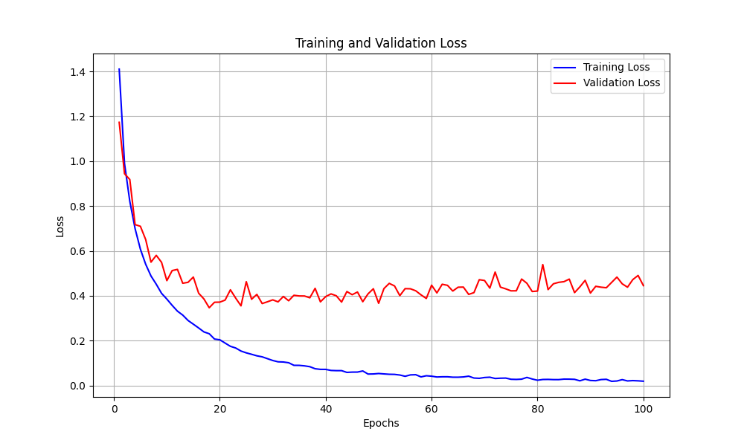
Loss Curves for Baseline Training
Teacher Model: ResNet-10

Slide 11
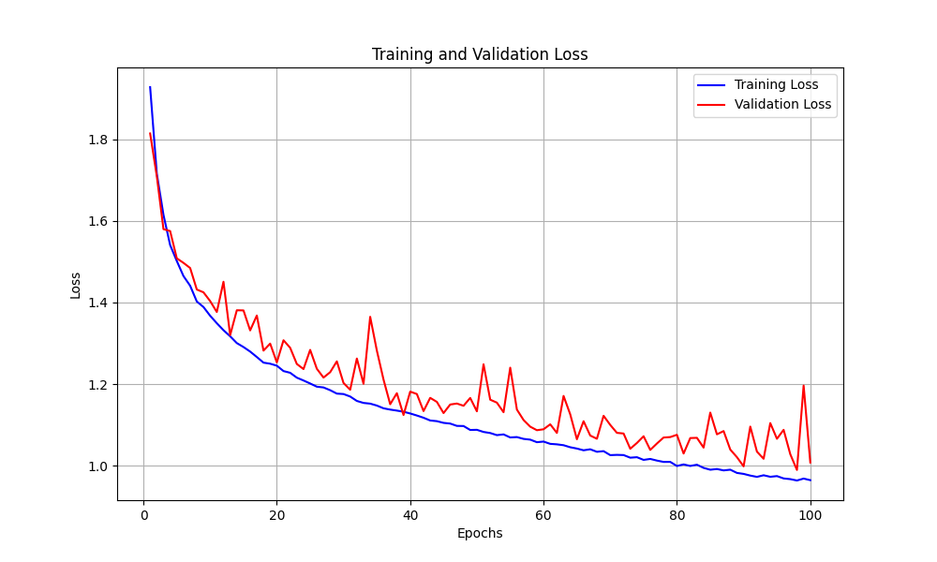
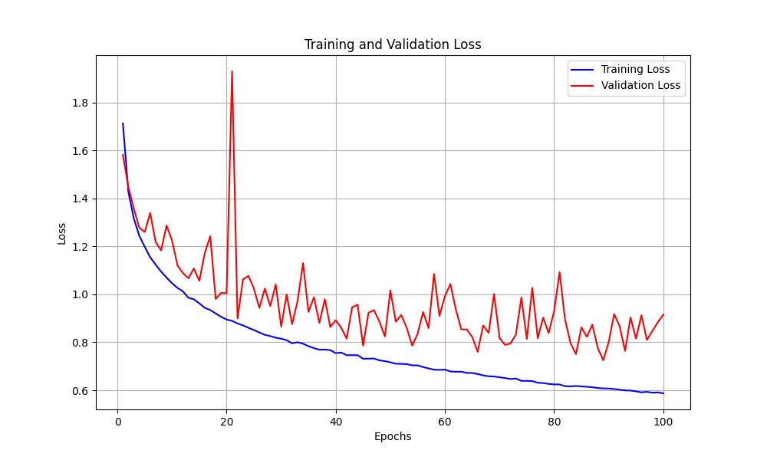
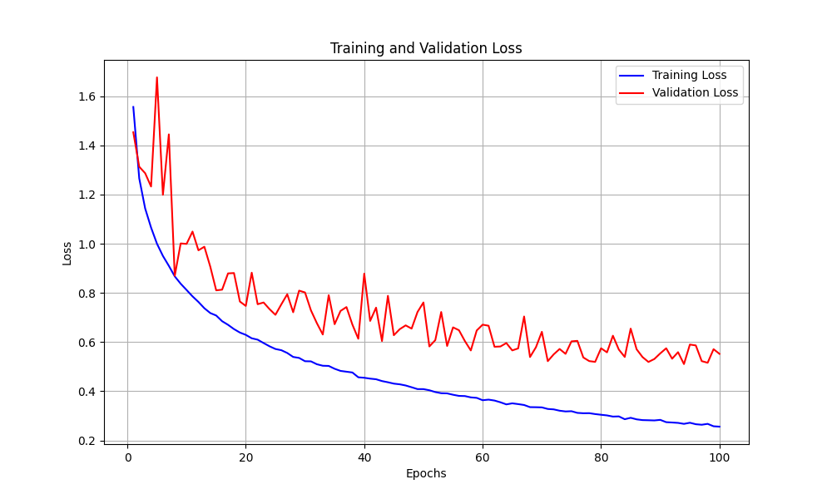
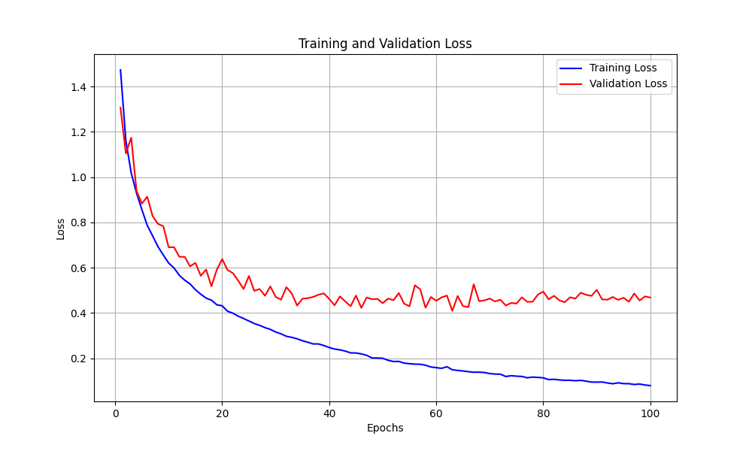
Loss curve for Baseline training
Resnet-3 | Resnet-4
Resnet-5 | Resnet-6

Slide 12
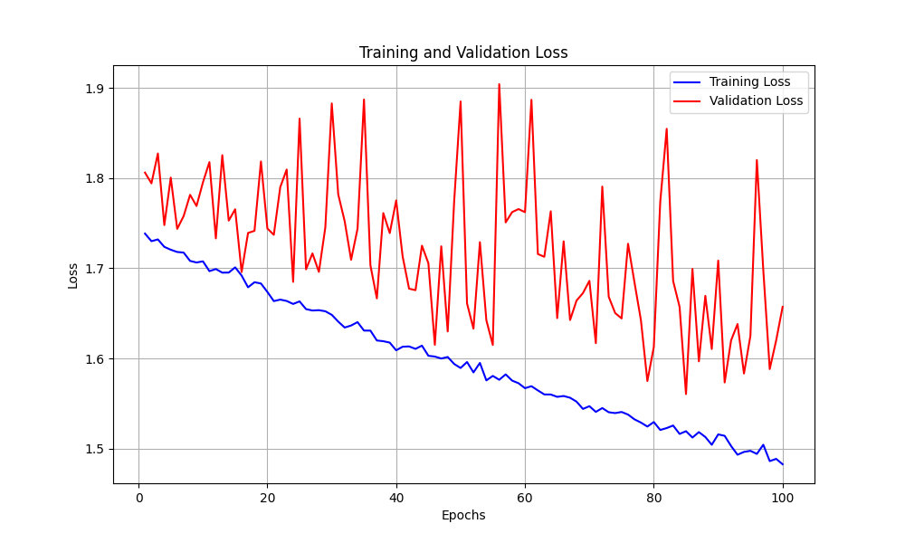
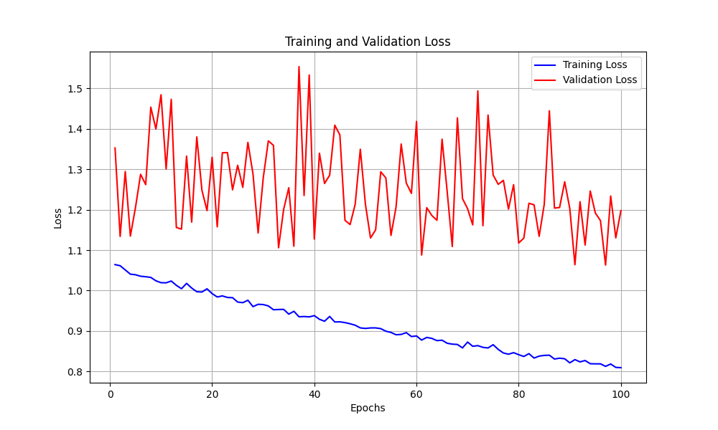
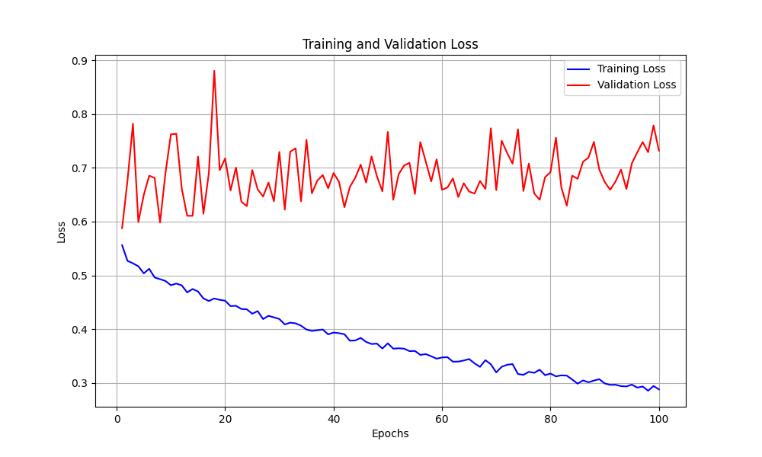
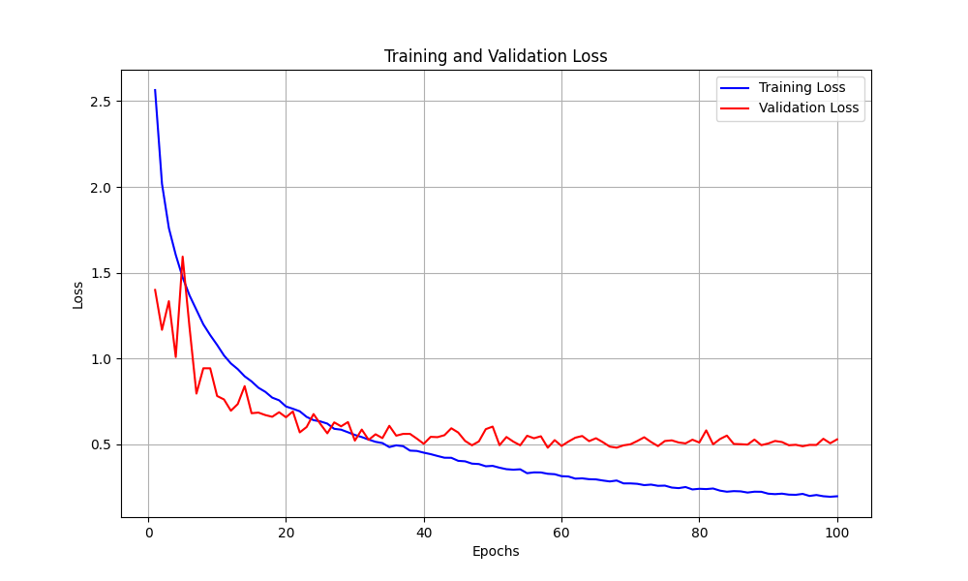
Loss Curves for KD training
Resnet-3 | Resnet-4
Resnet-5 | Resnet-6

Slide 13
Conclusion
KD does improve accuracy for small and moderate model sizes
For relatively larger like resnet-6 there was no improvement
Effect of KD is best for resnet-4
as it has the capacity to learn from teacher model
Learning from hard label for smaller model is hard

Slide 14
References
https://pytorch.org/tutorials/beginner/knowledge_distillation_tutorial.html
https://arxiv.org/pdf/1503.02531

